Slide 1
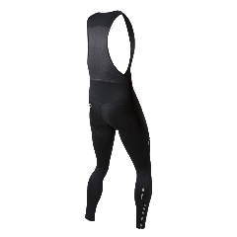
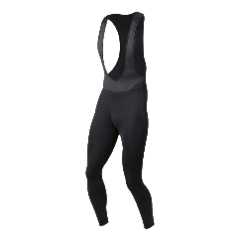


F21:ROAD – THERMAL TIGHTS
41112140
SELECT ESCAPE THERMAL CYCLING BIB TIGHT |€119.95
AVAILABLE: FALL – 1st ship ONLY
The Men’s Select Escape Thermal Tight is a mid-weight bib tight that keeps you warm and comfortable on cool to cold weather rides, making them a go-to Autumn and mild Winter day essential.
Brushed fleece thermal fabric: 90% polyester / 10% lycra
Anatomic, multi-panel design
Flatlock seams for excellent stretch and appearance
Mesh bib upper provides stability and suppot
7” lower leg zipper with zipper garage to protect ankle
Warm, stretch Thermal fabric behind knee for comfort and breathability
BioViz “Black reflective” elements for low-light visibility
SELECT Escape 1:1 chamois for chafe free comfort
28.5” inseam (size M)
FALL 2021
PEARL iZUMi
SIZES: S-XXL

Slide 2
F21:ROAD – THERMAL TIGHTS
41112139
SELECT ESCAPE THERMAL BIB TIGHT |€99.95
AVAILABLE: FALL – 1st ship ONLY
The Men’s Select Escape Thermal Tight is a mid-weight bib tight that keeps you warm and comfortable on cool to cold weather rides, making them a go-to Autumn and mild Winter day essential.
Brushed fleece thermal fabric: 90% polyester / 10% lycra
Anatomic, multi-panel design
Flatlock seams for excellent stretch and appearance
Mesh bib upper provides stability and suppot
7” lower leg zipper with zipper garage to protect ankle
Warm, stretch Thermal fabric behind knee for comfort and breathability
BioViz “Black reflective” elements for low-light visibility
No chamois; design to be worn over your favorite chamois bibs or shorts
28.5” inseam (size M)
FALL 2021
PEARL iZUMi
SIZES: S-XXL

